Slide 1

amzbank
Big Data Proposal for
AMZ BANK
Sumeyye Zeynep Bulbul,
Tamara Mai,
Mehmet Yilmaz
Notes:
*

Slide 2

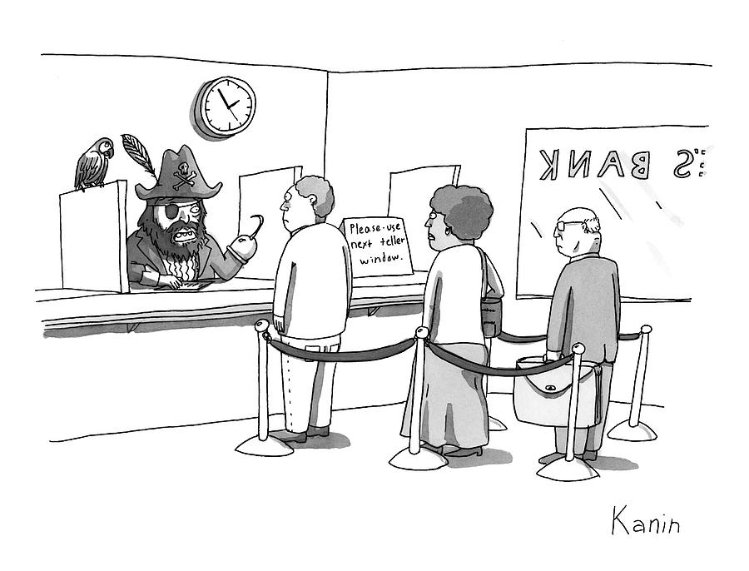

Key Trends
amzbank
Credit card companies who use big data are thriving
But AMZ Bank’s credit card is struggling:
We have 25% customer churn rate
Our service is not efficient
Our ads are not effective
We want to:
Keep good customers
Improve efficiency
Reduce churn rate
Notes:
OBJECTIVES:
Differentiate the active and paying customers from the not-so-paying customers
Maximize the number of active card users by better targeting incentives to those who most likely to activate and use for their business transactions
Reduce overheads on maintaining not-so-paying customers
Get 360-degree view of the customers
Reduce loss of customers to their competitors
Need a quick, flexible, affordable, and simple-to-use analytic architecture to solve the problems
Efficiency is a top consideration
*

Slide 3
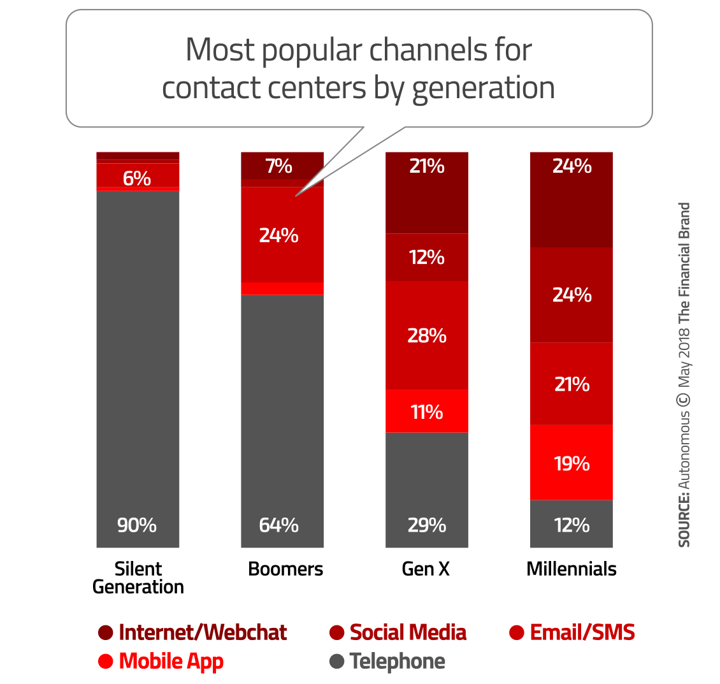
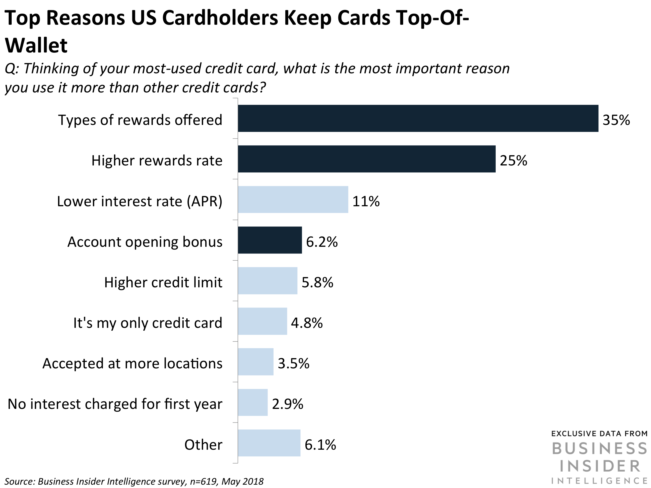
Key trends
33% of customers abandoned a business relationship because of lack of personalization in the service.
60% bank customers like rewards
Digital communication is increasingly preferred
Notes:
Source: https://thefinancialbrand.com/72653/artificial-intelligence-trends-banking-industry/

Slide 4
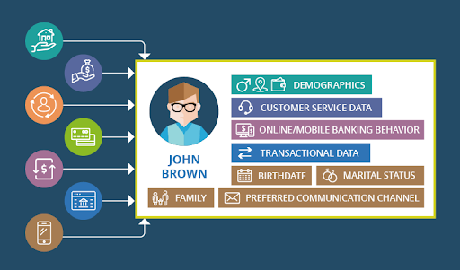
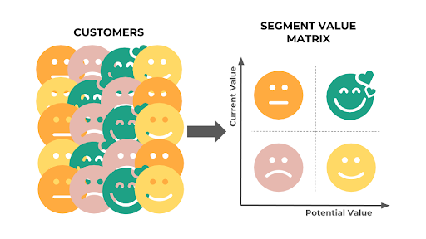


Solutions Needed
Problems:
Keep good customers
Improve efficiency
Reduce churn
Solutions Needed:
Customer profiling
Personalized services
AI chat bot
Big data analytics
Notes:
*

Slide 5
Proposed Solutions & Benefits
Customer profiling
Use available data to gain a complete view of a customer
Tailor the customer experience to each individual
Understand how customers buy
Identify opportunities for upselling
Reduce the risk of fraudulent behavior
Personalized services
Make the right engagement with the right customer at the right time
Personalize easy-to-use loyalty program
Increase customer retention
AI chat bot
Is a banking solution to social distancing
Make smart conversations with millions of customers instantly
Automate responses to multiple customers’ questions and complaints simultaneously
Streamline customer feedback
Enhance customer experience
Big data analytics
Weblog clickstream, transactional, sentiment, & predictive analytics
Notes:
Sources:
CUSTOMER PROFILING https://us.hitachi-solutions.com/blog/big-data-banking/
Customer segmentation has become commonplace in the financial service industry because it enables banks and credit unions to separate their customers into neat categories by demographic, but basic segmentation lacks the granularity these institutions require to truly understand their customers’ wants and needs. Instead, these institutions need to use big data in banking to take segmentation to the next level by building detailed customer profiles. These profiles should account for a variety of factors, including:
The customer’s demographic
How many accounts they have
Which products they currently have
Which offers they’ve declined in the past
Which products they’re likely to purchase in the future
Major life events
Their relationship to other customers
Attitude toward their bank and the financial services industry as a whole
Behavioral patterns
Service preferences
PERSONALIZATION https://www.bcg.com/publications/2019/what-does-personalization-banking-really-mean.aspx
33% of customers abandoned a business relationship because of lack of personalization in the service
Research on reasons customers use cards: type of rewards 35%; high rewards rate 25%; interest rate 11%; account opening bonus 6% (Business Insider Intelligence)
AI CHATBOT https://chatbotsjournal.com/rise-of-ai-powered-chatbots-in-the-banking-industry-782a74b9bf43
https://www.infopulse.com/blog/how-rpa-and-ai-revolutionize-the-banking-finance-industry/ (chatbot benefits bar chart)

Slide 6
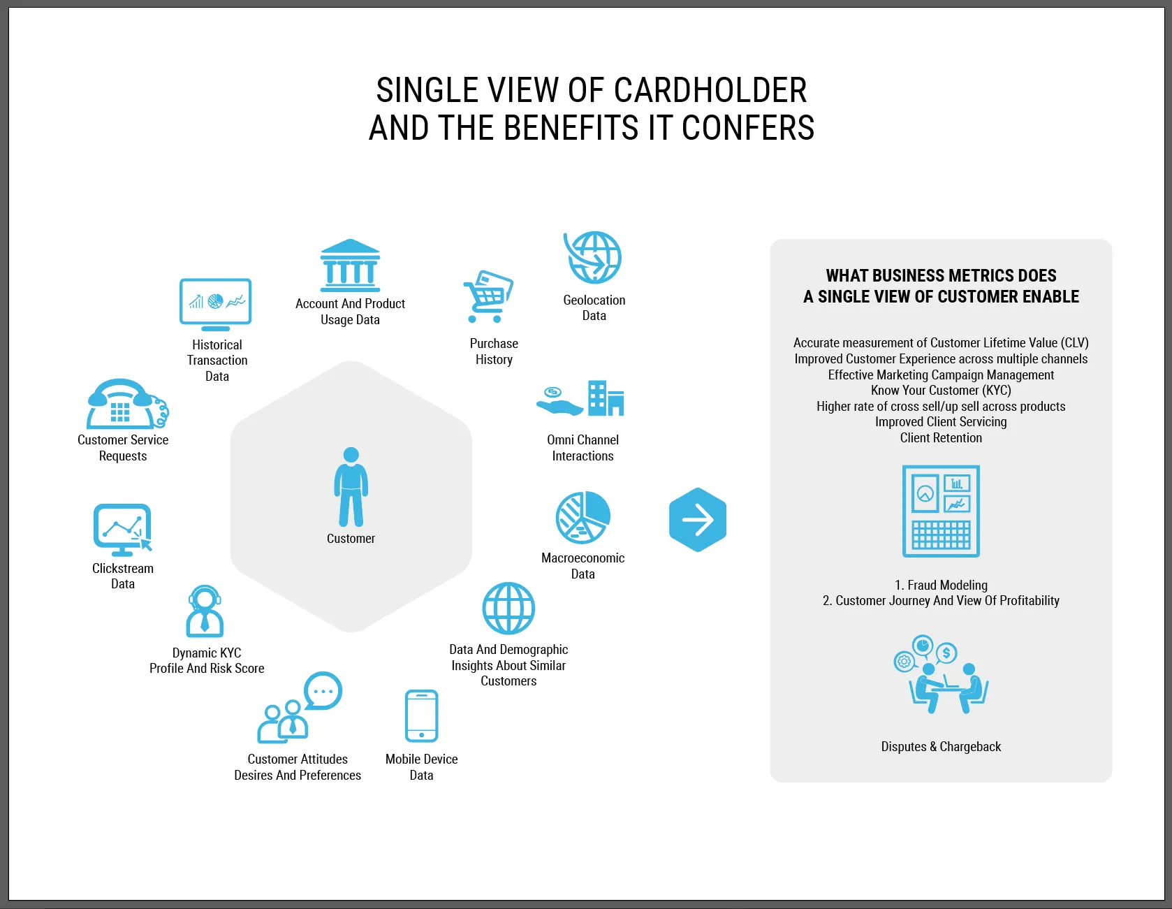
Customer 360
Notes:
“Social media, as an example, should be tapped as a big source of input into fraud analytics, because it captures self-declared events, such as a move to a new place or a new driver in the family, which may be different than the information reported when purchasing a policy or filing a FNoL.
With such advanced technologies, today’s insurers can anticipate, detect, and prosecute fraud more quickly and forcefully. And every dollar invested in fighting fraud can return exponential savings to the bottom line.
“

Slide 7
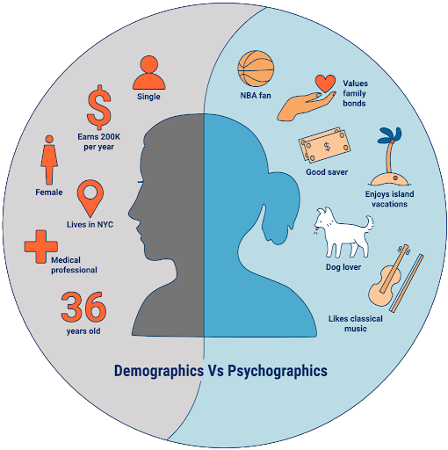
Customer profiling example
According to AMZ’s customer profile of Dana:
She’s a woman in her late 30s, which means she’s a member of Generation X
Her attitude toward the financial services industry is more favorable than those of her Millennial counterparts and, so far, she’s very happy with AMZ’s service.
Dana is college educated
She lives just outside Chicago, IL.
She has been married for the past four years.
When Dana joined AMZ, she was earning a median salary, but a recent promotion has pushed her into a higher income bracket.
At present, Dana has two accounts — a primary checking account and a high-interest savings account — and a credit card with AMZ bank
A homeowner, Dana also has a home mortgage with a different bank.
Dana’s a big fan of online banking
She checks her accounts at least once a day through AMZ mobile application, and has only submitted two service requests to date, both of which were resolved within 24 hours.
AMZ already knows what Dana’s monthly paycheck is, that she likes to pay her bills early, and that she puts an average of $500 into a high-interest savings account per paycheck.
One day, while reviewing Dana’s transaction history, an AMZ employee notices that she recently purchased plane tickets for her and her partner to a few different cities across Europe and South America, as well as booked hotels for each location.
Prior to embarking on a trip to Barcelona, Dana notifies her bank that she’ll be traveling out of the country so that it won’t put a freeze on her account while she’s abroad.
Notes:
Sources: https://us.hitachi-solutions.com/blog/big-data-banking/

Slide 8
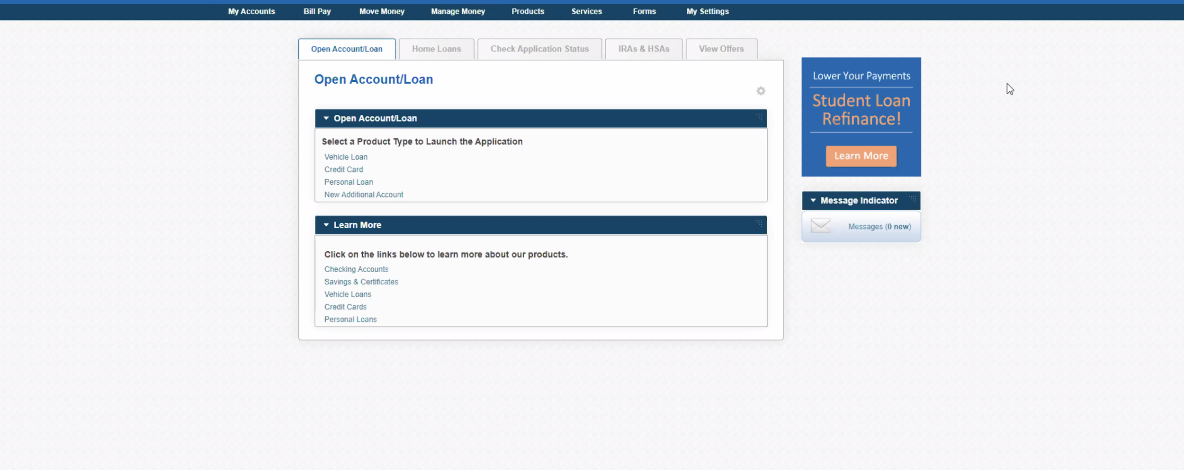
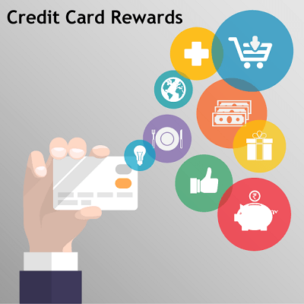

Solution Design:
Personalized service

Slide 9
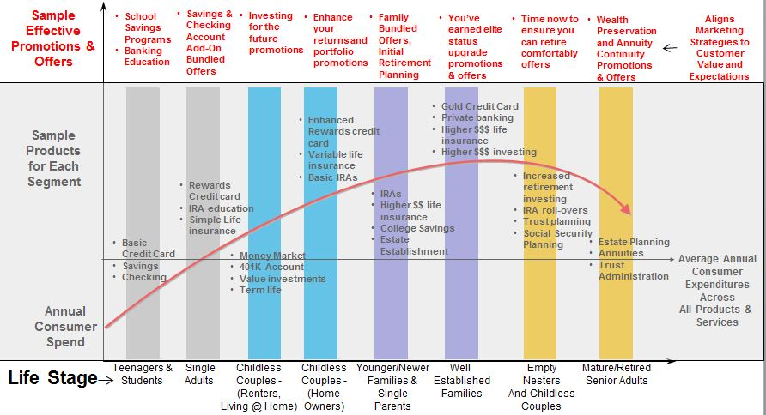
Solution Design:
Customer profiling
Notes:
Source: https://stevenjeffes.wordpress.com/tag/life-stages-in-customer-segmentation/

Slide 10
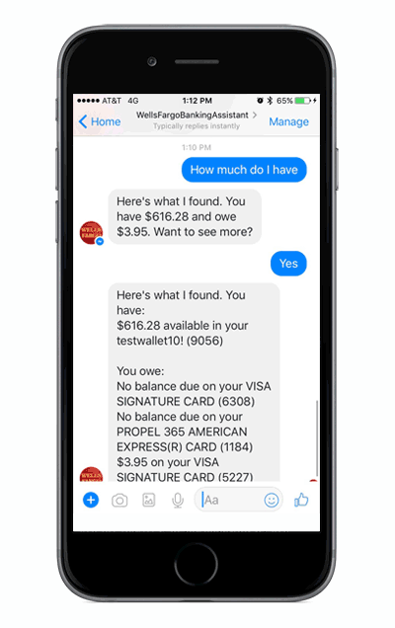
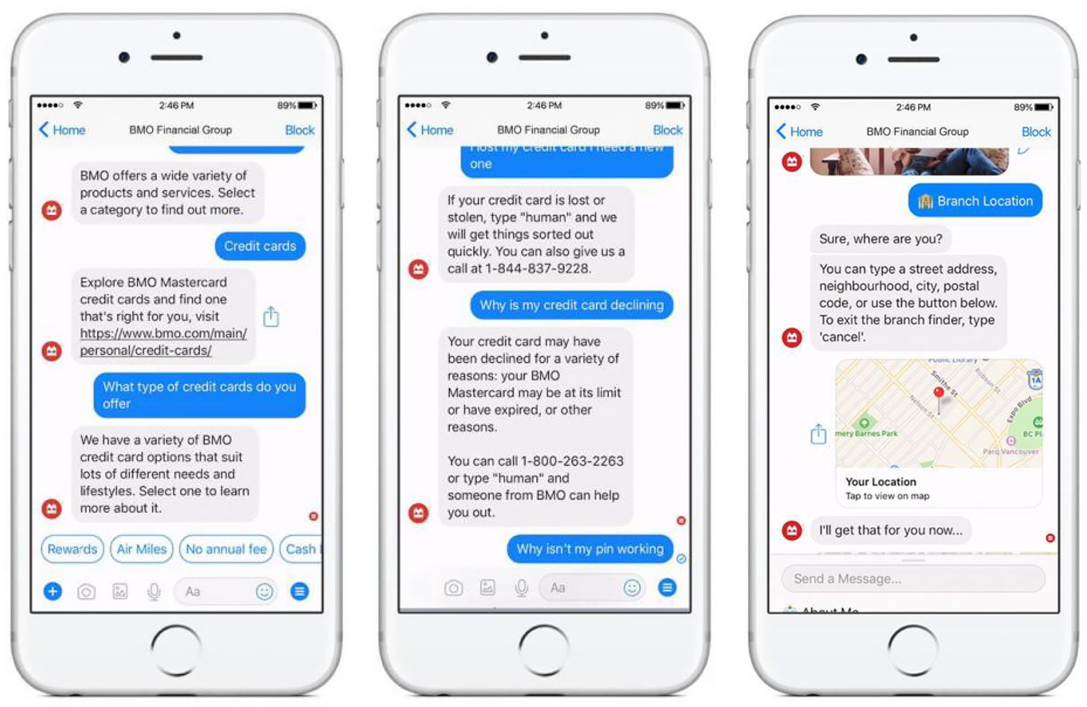
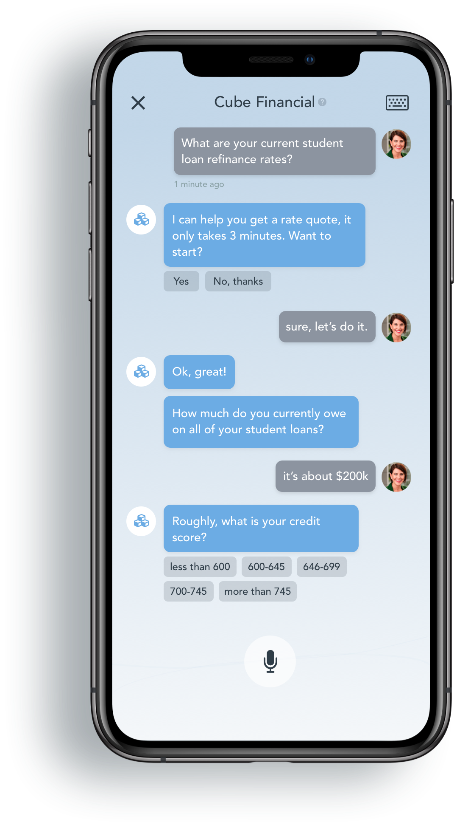
Solution Design:
AI Chat Bot

Slide 11
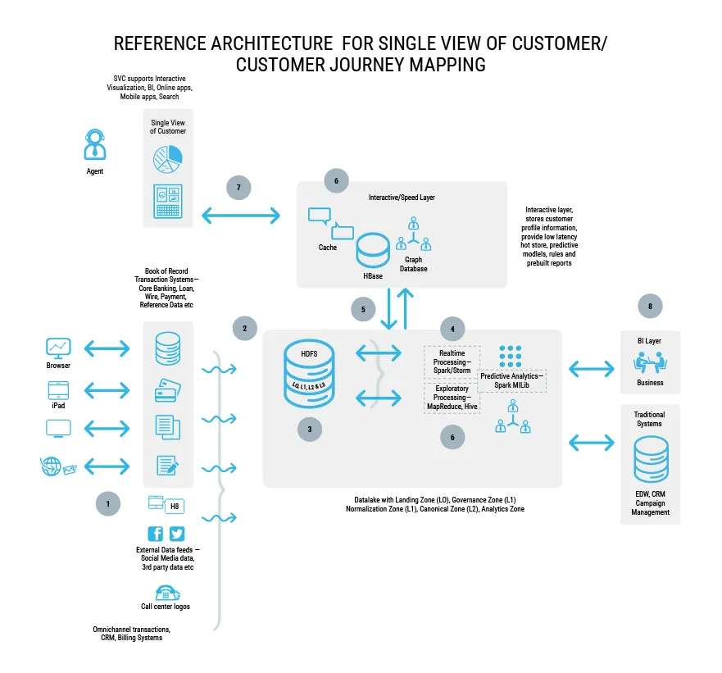
















Data flow architecture

Slide 12
Recommended Tech stacks
Data Layer - HDFS
Data Ingestion Layer- Flume, Sqoop, Kafka
Data Processing Layer –
Spark ML, Storm, Hive
Data Presentation Layer (Analysis) – BI Tools, Tableau, Kibana
Interactive/Speed Layer – Redis, Hbase, Neo4j
Operations and Scheduling layer – Oozie, Zookeeper
Data Access Layer – Scala, Kibana, Python, elasticsearch, logstash

Slide 13

Deployment strategy
Understand your big data needs
Organize your big data priorities
Analyze your big data analytics needs
Get your stakeholders excited about big data analytics
Pilot a project
Decide cloud and packaged solutions
Analyze results, improve, & do more projects
Think agile
Notes:
Source: https://www.datameer.com/blog/best-practices-deploying-big-data-analytics/
QUESTIONS AND CONSIDERATIONS:
Understand your big data needs
What products or solutions are you using today to deliver analysis to your stakeholders? How would you rate the solution? (Love, like, hate — easy to use, moderately easy to use, or hard to use)
What do you use these products for today?
What analysis, reports or data would you like to have that you don’t have today?
How would you improve your system or processes if you could?
Organize your big data priorities
Identify key business use cases
Align teams on priorities
Secure that really essential business buy-in on projects
Analyze your big data analytics needs
Infrastructure: What do you have installed today? What can you reuse? What can you use better? What do you need to buy?
Solution: Which solutions that you want to purchase meet the needs of the high-priority use cases?
Which solutions can you purchase that will have longevity? Recall that a part of this process is the rinse-and-repeat characteristic of analysis. Analysis doesn’t happen as a one-and-done event; rather it’s a journey and the path winds. The blueprint for success can be executed many times before building and deploying the correct structure. Select a packaged solution that delivers all the capabilities you need today and some capabilities that you want for tomorrow.
People: Who are the people experts who have interest in building new solutions for your business? What can you easily do today? What are these business users’ career aspirations, and does this solution fall into that?
Get your stakeholders excited about big data analytics
Socialize: People have to get excited and looking forward to new tools and ways to deliver the content to their stakeholders. Do it in the right way, and they’ll become an organizational change maker or hero. In addition, you want buy-in from as many people as possible and that means making them feel like they’re a part of the process and the project. Talk about your ideas before you get too far down the road. You want plenty of feedback so you know which objections to handle later on, or solutions to brainstorm so you’re not caught off-guard by unaddressed questions during presentations.
Improve: You want your stakeholders to feel invested in the solutions that are being rolled out to them. By incorporating their insights into what needs to be done, these people will be more willing to:
Attend training
Spend time delivering constructive feedback on the experience
Share with others the desire to use the tools
Constantly reevaluate and ask whether you’re optimizing and evolving the solution as needed. Remember, the big data analytics environment is constantly changing and growing bigger so you’ll want to be sure your choice will be continue to be a good choice.
Organize: Last of all, make sure your process is organized. You want your stakeholders and solution providers to feel on top of things, and ready to charge in there to support your decision. Ensuring transparency between everyone will drive agility, rapid implementation and high adoption.
Pilot a project
Use cloud or packaged solutions
Analyze results, improve, & do more projects
Think agile

Slide 14
Deployment Strategy
Phase 1: Present
Cloud Migration: XX-node AWS Cluster
Transaction Analysis
Web Log Analysis & “Track every click of the customers on the bank website”
Churn Analysis
Customer Profiling & “Divide the customers into groups depends on their behaviors”
One month of development
Budget request: ($100 millions)
3.8 petabyte data
Phase 2: Future
Scale out to XX-node AWS Cluster
Predictive Analysis
Customer Scoring Models, Fraud Detection Algorithm using:
Claims Data, CDR, Weblogs, Social Media
XX GB of data per day
One month of development
Budget request: ($50 millions)

Slide 15
Summary
Big data delivers results:
Customer profiling & personalized services:
Reduce churn: 33% of customers abandoned a business relationship because of lack of personalization in the service.
Revenue growth: “For every $100 billion in assets that a bank has, it can achieve as much as $300 million in revenue growth by personalizing its customer interactions.”
AI chat bot:
Cost saving: “For every query handled by a chatbot, banks save not just 4 minutes of human staff’s time, but also leads to $0.70 average cost savings per chatbot interaction by 2022.”
Overall: Businesses that are able to quantify their gains from analyzing big data reported an average 8% increase in revenue and a 10% reduction in overall costs
https://thefinancialbrand.com/72653/artificial-intelligence-trends-banking-industry/
Notes:
Sources:
Customer profiling: https://us.hitachi-solutions.com/blog/big-data-banking/
Personalization: https://www.bcg.com/publications/2019/what-does-personalization-banking-really-mean.aspx
AI chatbot: https://chatbotsjournal.com/rise-of-ai-powered-chatbots-in-the-banking-industry-782a74b9bf43

Slide 16
Summary
amzbank
“In a big data world, a competitor that fails to sufficiently develop its capabilities will be left behind.”
We hope you like our presentation. Any questions please ask.
Thank you for your time
Notes:
Source: Mckinsey Global Institute: Big data - The next frontier for innovation, competition, and productivity (May 2011)
*

